Slide 1
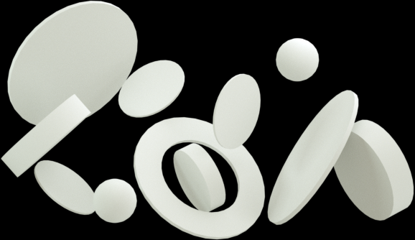




Smart Factory Insights - Predictive Maintenance and Remaining Useful Life Days Forecasting
-Presented By
Sakshi Bihani(09)
Manjiri Bedre(20)
Ashish Dhairya(05)
Hardik Sharma(15

Slide 2

Problem Statement
The primary business problem was to minimize operational losses caused by unexpected machine downtime. By predicting failures before they happen, companies can move from a reactive maintenance strategy (fixing things after they break) to a proactive one. This reduces repair costs, prevents cascading failures, and optimizes maintenance scheduling, directly improving production efficiency.

Slide 3

Introduction
This project delivers an end-to-end predictive maintenance solution for Industry 5.0 using the large-scale Factory Sensor Simulator dataset. Our pipeline leverages Apache Spark for processing and insights. We applied machine learning models, including Random Forest, XGBoost, and LightGBM to classify failure within 7 days and predict remaining operational life of IoT sensor. The framework culminates in a custom-built UI that serves as an interactive hub. It allows users to run instant predictions on new values by setting them through parameters while visualizing overall fleet health and failure risks on a real-time Tableau dashboard. This empowers smart factories with a powerful tool for proactive, data-driven maintenance, minimizing downtime.

Slide 4
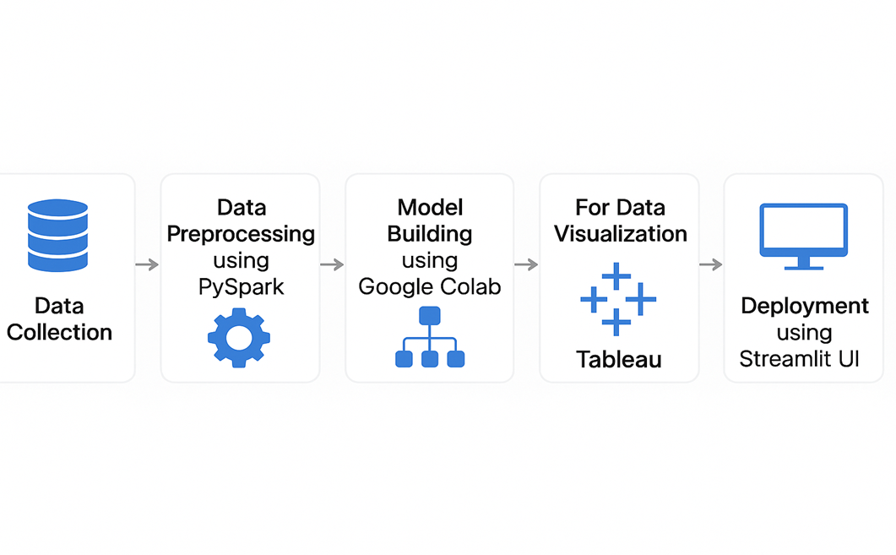
Workflow

Slide 5
Dataset
The name of our dataset is Industrial IoT Dataset we have taken our dataset from Kaggle. (Dataset Link)
This dataset contains sensor readings, operational metrics, and maintenance records from 500,000 simulated machines deployed in a futuristic smart factory environment. It includes:
30+ realistic machine types (e.g., CNC_Mill, Furnace, Robot_Arm, Laser_Cutter)
Core sensor data: temperature, vibration, sound, power, oil/coolant levels
Maintenance history and AI supervision fields
Machine-specific features like Laser_Intensity, Hydraulic_Pressure_bar, and more
Two target columns:
a. Remaining_Useful_Life_days (regression)
b. Failure_Within_7_Days (binary classification)

Slide 6
Data Pre-Processing
For data pre-processing we have used Apache PySpark.
We have followed following steps for that:
Null value imputation
Drop duplicates
Feature engineering
Drop unnecessary columns
Split X and Y
Standard Scaler
Checking distribution of data
Outlier Detection

Slide 7

Data Models
LightGBM
A fast, high-performance gradient boosting framework using less memory.
Random Forest
An ensemble of decision trees for classification and regression.
XGBoost
A fast, scalable gradient boosting for structured data.

Slide 8
LightGBM
LightGBM (Light Gradient Boosting Machine) is a high-performance, open-source framework developed by Microsoft that utilizes gradient boosting with decision trees.
It is specifically engineered for speed and efficiency, making it a popular choice for tasks like classification, regression, and ranking, especially with large datasets.
Key advantages include significantly faster training times, lower memory usage, and high accuracy.
Its effectiveness stems from innovative techniques like a histogram-based algorithm and a leaf-wise tree growth strategy, enabling it to handle massive datasets and high-dimensional features with ease.

Slide 9
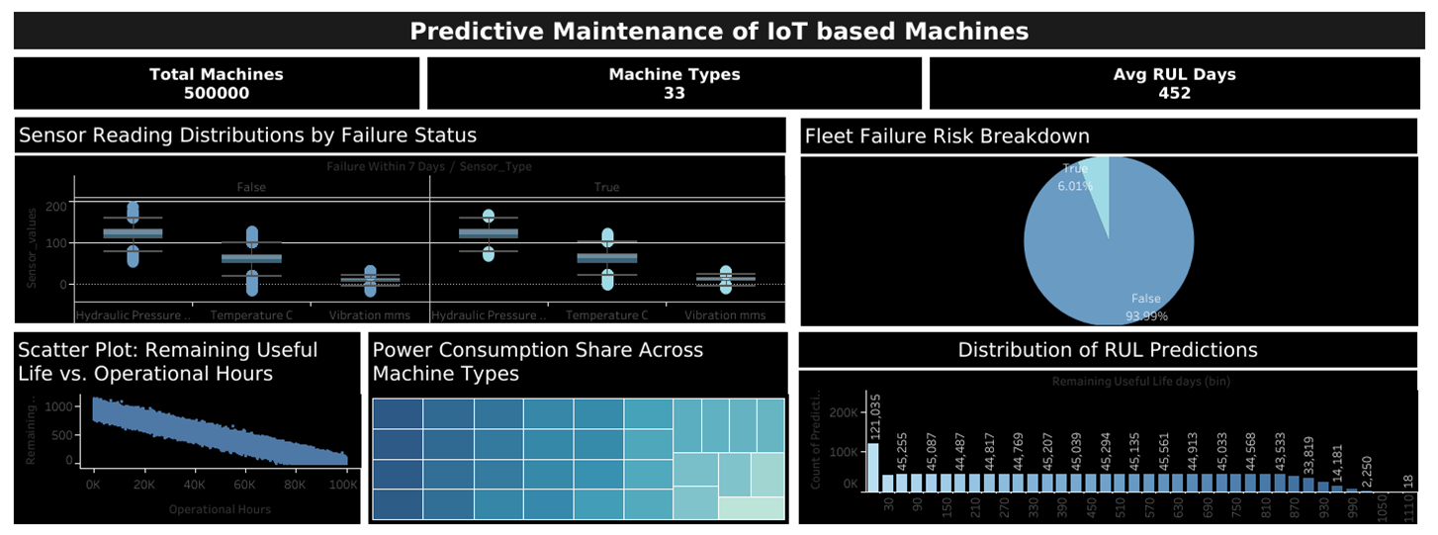
Dashboard

Slide 10
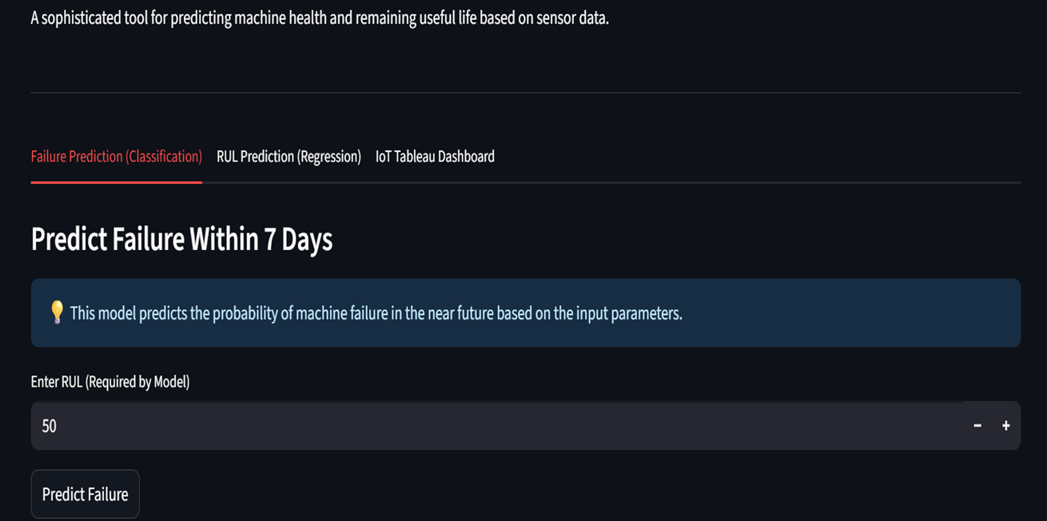
Streamlit : Classification

Slide 11
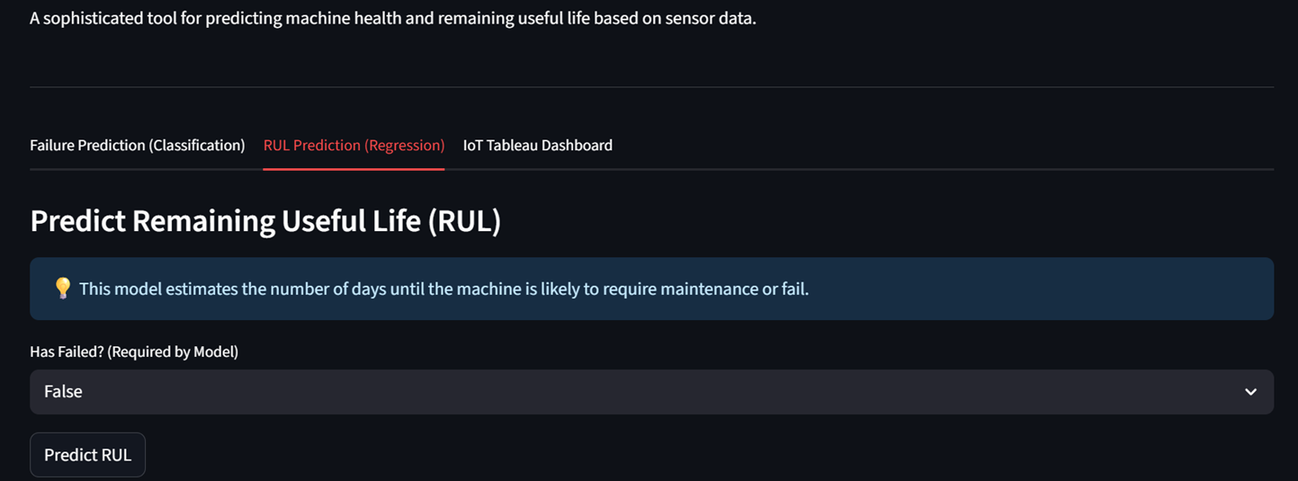
Streamlit : Regression

Slide 12
Conclusion
The developed machine learning system successfully provides real-time failure prediction and Remaining Useful Life (RUL) estimation using sensor data.It shifts maintenance from reactive to proactive strategy, enabling companies to avoid unexpected breakdowns and reduce maintenance costs. LightGBM Classifier was selected for failure classification due to high accuracy of 95% and log loss of 0.1440. LGBMRegressor was chosen for RUL prediction with mean square error of 2336.3539 and R² score 0.972. The solution was deployed via an interactive Streamlit dashboard, allowing real-time prediction for technicians and engineers.

Slide 13
GitHub Link
https://github.com/hardiksd7/Smart-Factory-Insights

Slide 14
THANK
YOU

